Slide 1
Simulations
New topic. This topic will be used as content for your next assessment.
Be aware that this is not the probability and loans test 3 it will be statistical investigation 2
EQ – How do I calculate the probability of an expected event?

Slide 2
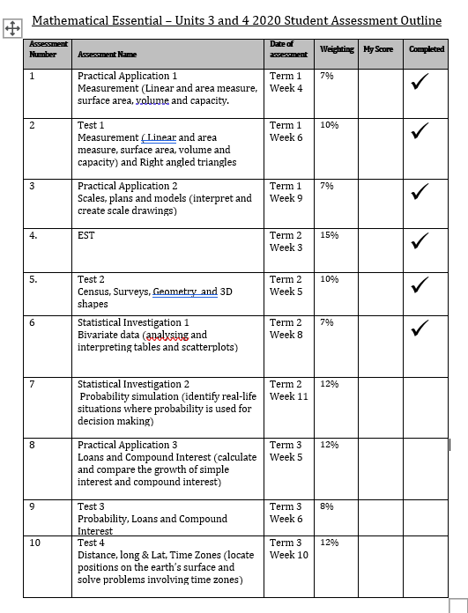

Slide 3
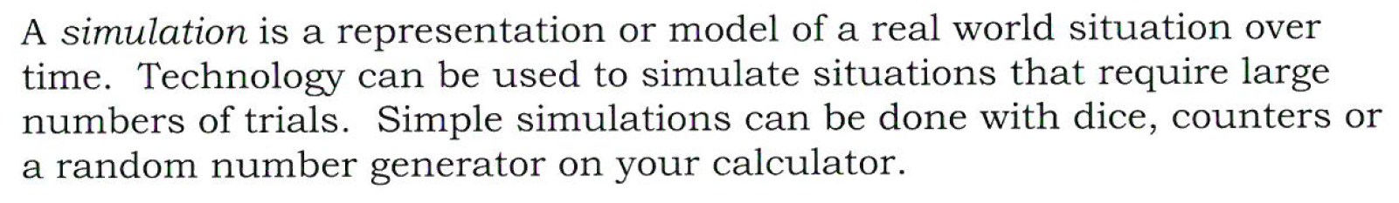
24
7
30
Simulations
Date
EQ – How do we run simulations?
What is a Simulation?

Slide 4
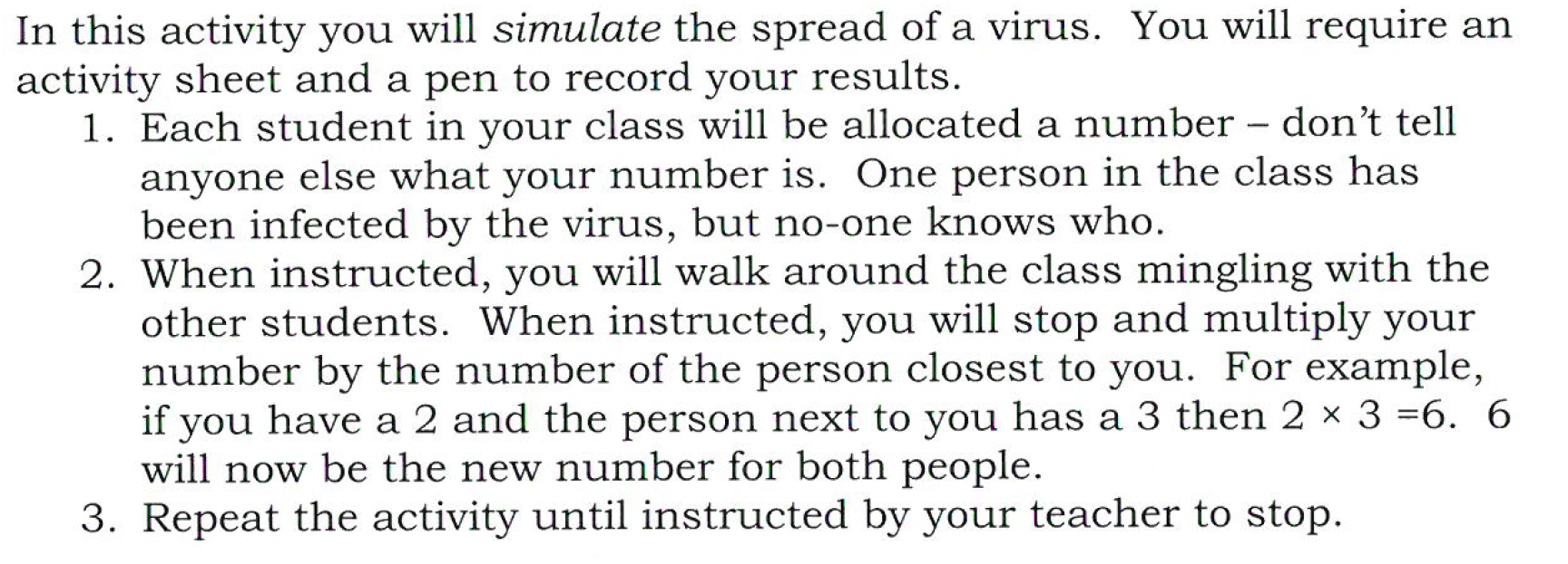
Simulation Activity
Notes:
See teacher notes form MAWA textbook on this

Slide 5


Slide 6
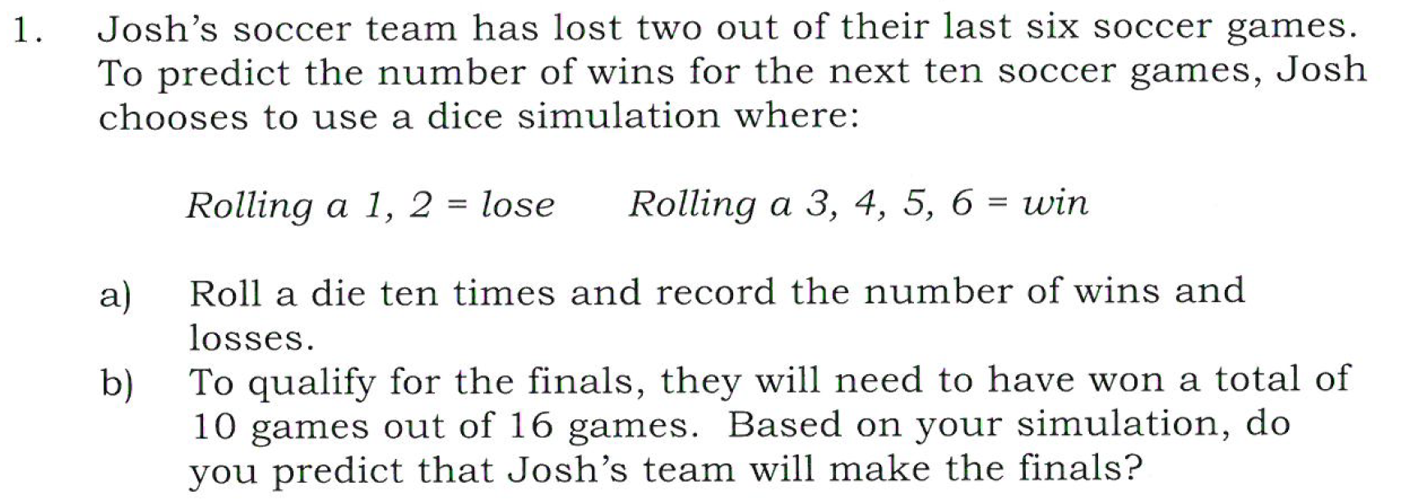
Task

Slide 7
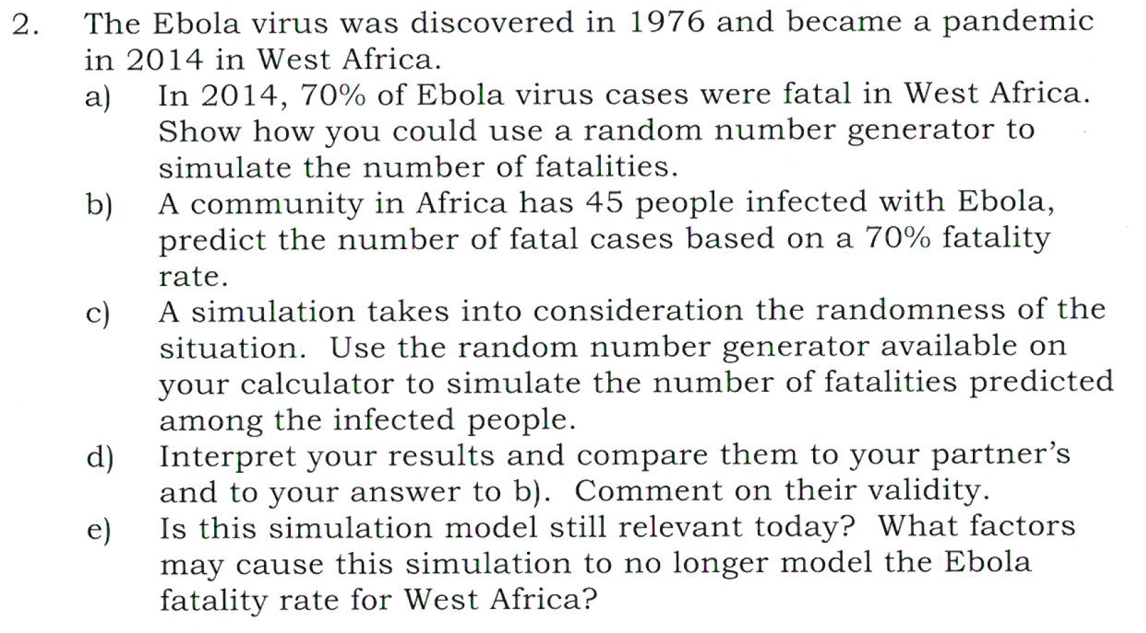
Task
https://www.google.com.au/search?q=random+number+generator&ie=&oe=
Notes:
Use scientific calculator: alpha- decimal- add in numbers use shift ) to put comma in between

Slide 8
Task
Tasty Burger task class task
- 1 lesson practice for Inv
https://www.google.com.au/search?q=random+number+generator&ie=&oe=

